Slide 1

Ray
July 2022

Slide 2
Table of Contents
Architecture
Object and Object Store
Memory Management
Resource Management
Scheduling

Slide 3
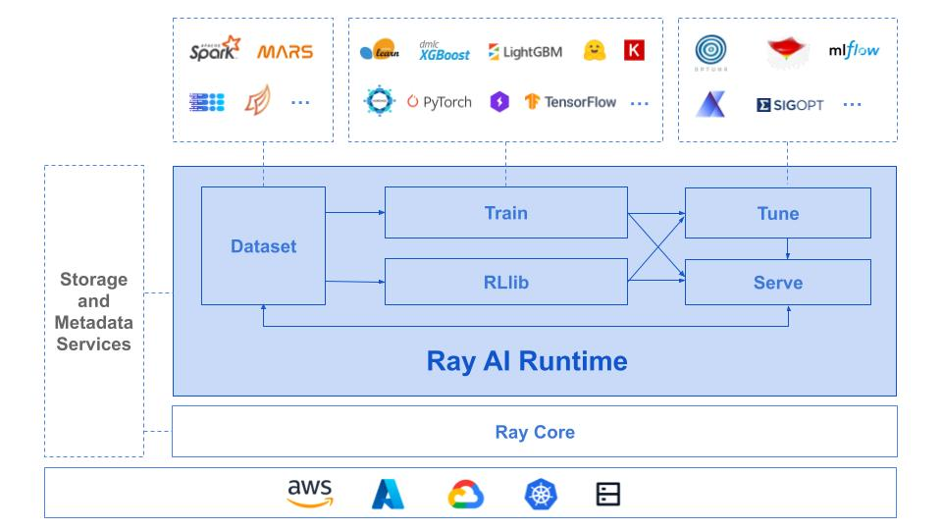
Ray: A Distributed ML Framework [1,2]
Architecture
Object
Memory
Resource
Scheduling
A distributed execution framework for emerging AI applications
Apps and libraries
Ray
Cloud service providers
[1] https://www.usenix.org/conference/osdi18/presentation/moritz
[2] https://docs.google.com/document/d/1lAy0Owi-vPz2jEqBSaHNQcy2IBSDEHyXNOQZlGuj93c/preview

Slide 4
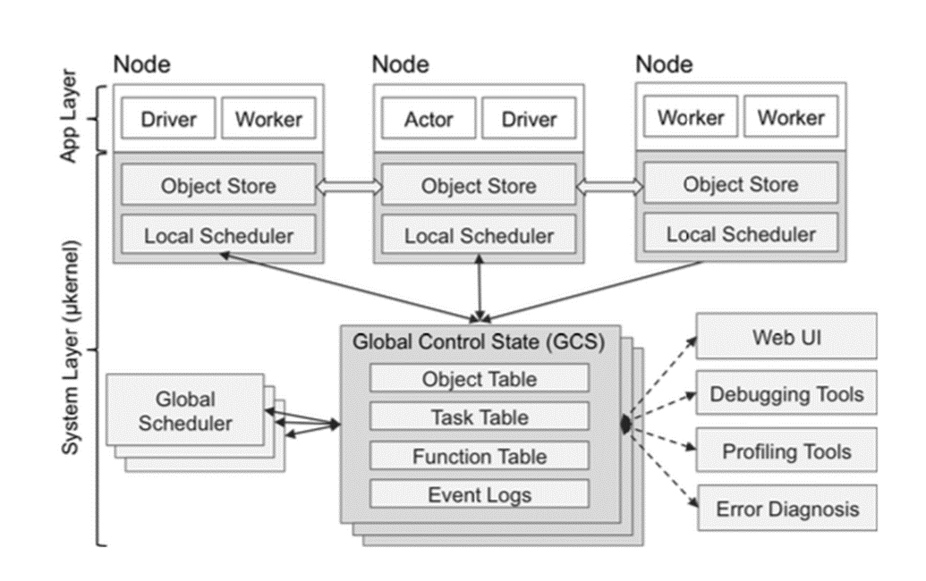
Ray: Architecture
Architecture
Object
Memory
Resource
Scheduling
Ray’s architecture consists of two parts: an application layer and a system layer.
Application layer:
Worker: a stateless process that serially executes tasks (remote functions) invoked by a driver or another worker. Workers are started automatically and assigned tasks by the system layer. When a remote function is declared, the function is automatically published to all workers.
Driver: a special worker process that executes the top-level application. It can submit tasks, but cannot execute any itself. Driver processes can run on any node.
Actor: a stateful process that serially executes, when invoked, the methods it exposes. Unlike a worker, an actor is explicitly instantiated by a worker or a driver.

Slide 5
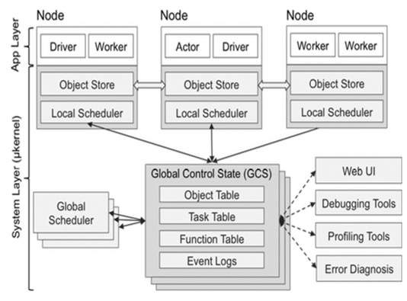
Ray: Architecture
Architecture
Object
Memory
Resource
Scheduling
Worker
a stateless process that serially executes tasks (remote functions) invoked by a driver or another worker. When a remote function is declared, the function is automatically published to all workers.
started automatically and assigned tasks by the system layer.
Driver: a special worker process that executes the top-level application. It can submit tasks, but cannot execute any itself. Driver processes can run on any node.
Actor: a stateful process that serially executes, when invoked, the methods it exposes. Unlike a worker, an actor is explicitly instantiated by a worker or a driver.

Slide 6
Ray: Architecture
Architecture
Object
Memory
Resource
Scheduling
Worker
a stateless process that serially executes tasks (remote functions) invoked by a driver or another worker. When a remote function is declared, the function is automatically published to all workers.
started automatically and assigned tasks by the system layer.
Driver
a special worker process that executes the top-level application.
It can submit tasks but cannot execute any itself.
Driver processes can run on any node.
Actor: a stateful process that serially executes, when invoked, the methods it exposes. Unlike a worker, an actor is explicitly instantiated by a worker or a driver.

Slide 7
Ray: Architecture
Architecture
Object
Memory
Resource
Scheduling
Worker
a stateless process that serially executes tasks (remote functions) invoked by a driver or another worker. When a remote function is declared, the function is automatically published to all workers.
started automatically and assigned tasks by the system layer.
Driver
a special worker process that executes the top-level application.
It can submit tasks but cannot execute any itself.
Driver processes can run on any node.
Actor
a stateful process that serially executes the methods it exposes. Unlike a worker, an actor is explicitly instantiated by a worker or a driver.

Slide 8

Ray: Architecture
Architecture
Object
Memory
Resource
Scheduling
The System Layer consists of three major components: a global control store, a distributed scheduler, and a distributed object store. More details in slides later.
• Task - A single function invocation that executes on a process different from the caller. A task is executed asynchronously with the caller.
• Object - An application value. This may be returned by a task or created through `ray.put`. Objects are immutable: they cannot be modified once created. A worker can refer to an object using an `ObjectRef`.
• Job - The collection of tasks, objects, and actors originating (recursively) from the same driver.

Slide 9
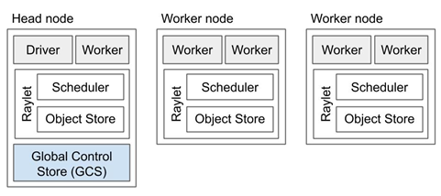
Ray: Architecture
Architecture
Object
Memory
Resource
Scheduling
A Ray cluster comprises a set of worker nodes and a centralized Global Control Store (GCS) instance.
Each worker node has:
1. One or more work processes, responsible for task submission and execution. Each is associated with a specific job. The default number of initial workers is equal to the number of CPUs on the machine.
2. A raylet. The raylet is shared among all jobs on the same cluster. The raylet has two main components, run on separate threads:
1). A scheduler. Responsible for resource management and fulfilling task arguments that are stored in the distributed object store. The individual schedulers in a cluster comprise the Ray distributed scheduler.
2). A shared-memory object store (also known as the Plasma Object Store). Responsible for storing and transferring large objects. The individual object stores in a cluster comprise the Ray distributed object store.
Each worker stores:
1). An ownership table. System metadata for the objects to which the worker has a reference, e.g., to store ref counts and object locations.
2). An in-process store, used to store small objects.

Slide 10
Ray: Architecture
Architecture
Object
Memory
Resource
Scheduling
Each worker node has:
1. One or more work processes, responsible for task submission and execution. Each is associated with a specific job. The default number of initial workers is equal to the number of CPUs on the machine.
Each worker stores:
1). An ownership table. System metadata for the objects to which the worker has a reference, e.g., to store ref counts and object locations.
2). An in-process store, used to store small objects.
One of the worker nodes is designated as the head node. In addition to the processes a worker load has, the head node also hosts:
The Global Control Store (GCS).
The driver process(es).

Slide 11
Ray: Architecture
Architecture
Object
Memory
Resource
Scheduling
Each worker node has:
One or more work processes, responsible for task submission and execution. Each is associated with a specific job. The default number of initial workers is equal to the number of CPUs on the machine.
2. A raylet. The raylet is shared among all jobs on the same cluster. The raylet has two main components, run on separate threads:
1). A scheduler. Responsible for resource management and fulfilling task arguments that are stored in the distributed object store. The individual schedulers in a cluster comprise the Ray distributed scheduler.
2). A shared-memory object store (also known as the Plasma Object Store). Responsible for storing and transferring large objects. The individual object stores in a cluster comprise the Ray distributed object store.
One of the worker nodes is designated as the head node. In addition to the processes a worker load has, the head node also hosts:
The Global Control Store (GCS).
The driver process(es).

Slide 12
Ray: Architecture
Architecture
Object
Memory
Resource
Scheduling
Each worker node has:
One or more work processes, responsible for task submission and execution. Each is associated with a specific job. The default number of initial workers is equal to the number of CPUs on the machine.
2. A raylet. The raylet is shared among all jobs on the same cluster. The raylet has two main components, run on separate threads:
1). A scheduler. Responsible for resource management and fulfilling task arguments that are stored in the distributed object store. The individual schedulers in a cluster comprise the Ray distributed scheduler.
2). A shared-memory object store (also known as the Plasma Object Store). Responsible for storing and transferring large objects. The individual object stores in a cluster comprise the Ray distributed object store.
One of the worker nodes is designated as the head node. In addition to the processes a worker load has, the head node also hosts:
The Global Control Store (GCS).
The driver process(es).

